Slide 1



INFOSYS SPRINGBOARD
SUMMARY
GUEST
CANCELLATION
REVENUE
HOTEL REVENUE PERFORMANCE ANALYSIS
This project presents a comprehensive analytical study of hotel revenue performance using Power BI. The dashboard evaluates key performance indicators such as Total Revenue, ADR, RevPAR, Occupancy Rate, Cancellation Rate, Seasonal Trends, and Booking Channel distribution to support strategic pricing and revenue optimization decisions.
PROJECT OVERVIEW
TEAM MEMBERS :
DIMPLE SHARMA
KARAN SINGH
DIVYA V
GUIDED BY :
KALAIVANI A
01

Slide 2

PROJECT STATEMENT
Hotels generate large volumes of booking, customer, and room data across multiple branches and channels.
However, without a structured analytical system, management struggles to monitor occupancy rates, ADR, RevPAR, guest segmentation, cancellation trends, and seasonal performance effectively.
This project, AI-Driven Revenue Analysis for Hotels, aims to build an interactive Power BI dashboard that integrates booking, customer, and room data to analyze revenue performance, forecast occupancy, evaluate cancellation impact, and support strategic pricing and upselling decisions.
02

Slide 3
OBJECTIVES
1
Analyze overall hotel revenue performance using interactive Power BI visuals
4
Examine booking duration patterns and cancellation impact
2
5
Monitor occupancy rate and room utilization efficiency
Compare room category performance and regional base pricing trends
3
6
Evaluate pricing performance through ADR and RevPAR analysis
Support data-driven revenue optimization and strategic decision-making
03

Slide 4
M1
M2
M3
M4
M5
DATA MODELING AND INGESTION
OCCUPANCY AND REVENUE METRICS
GUEST ANALYSIS MODULE
FORECASTING AND CANCELLATION TRENDS
REVENUE STRATEGY DASHBOARD
04

Slide 5




REQUIREMENT ANALYSIS
MICROSOFT EXCEL
Data Cleaning and Preprocessing
KAGGLE
Data Sourcing and Resources
POWER BI
Dashboard Creation and Development
MICROSOFT WORD
Documentation and Reporting
05

Slide 6
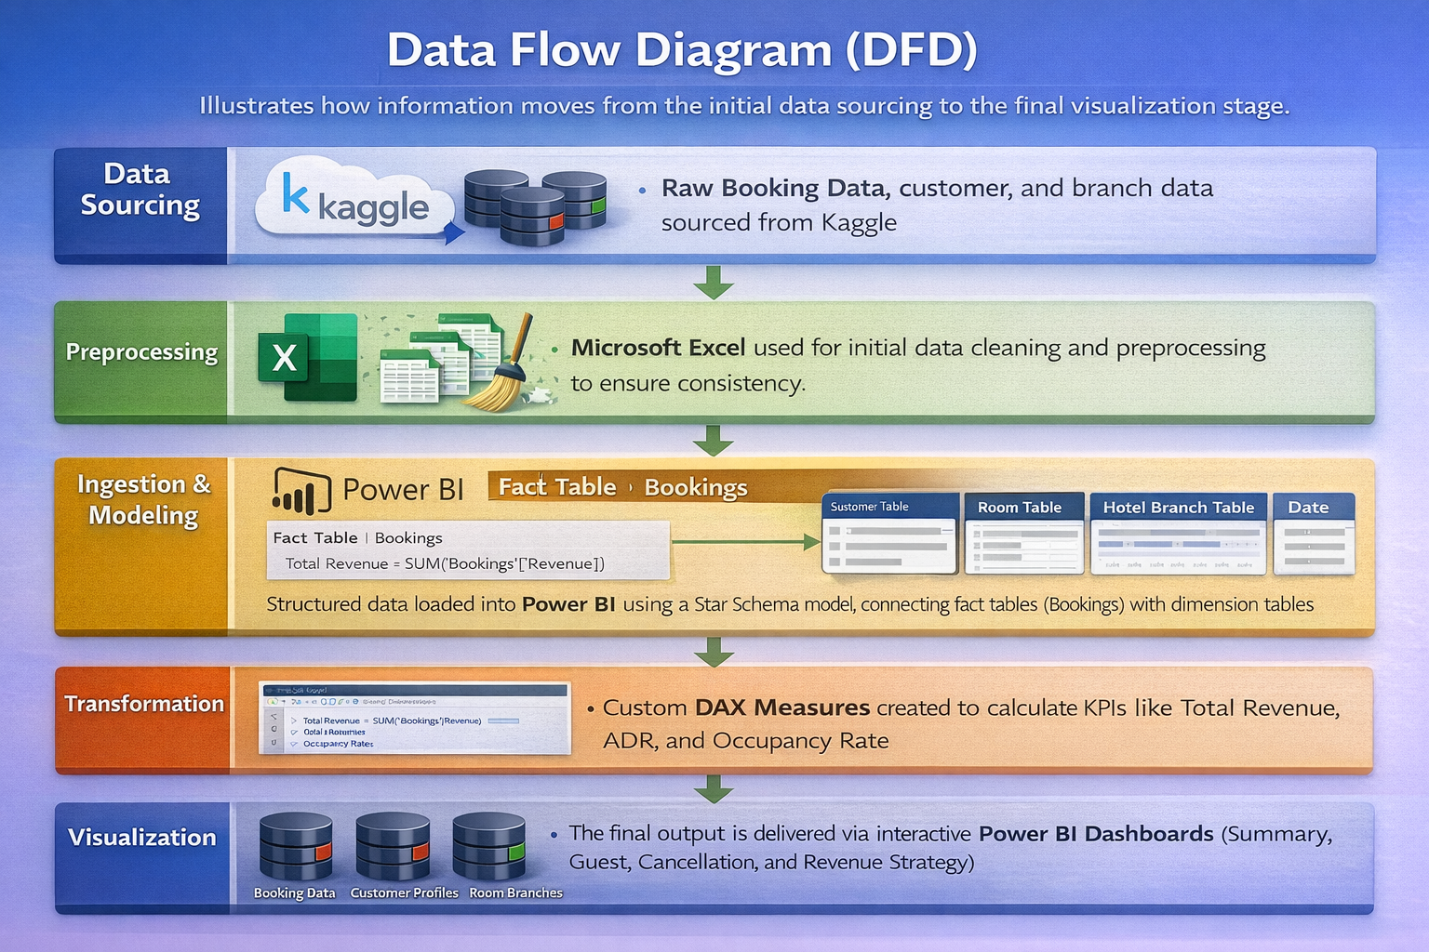
DATA FLOW DIAGRAM
03

Slide 7
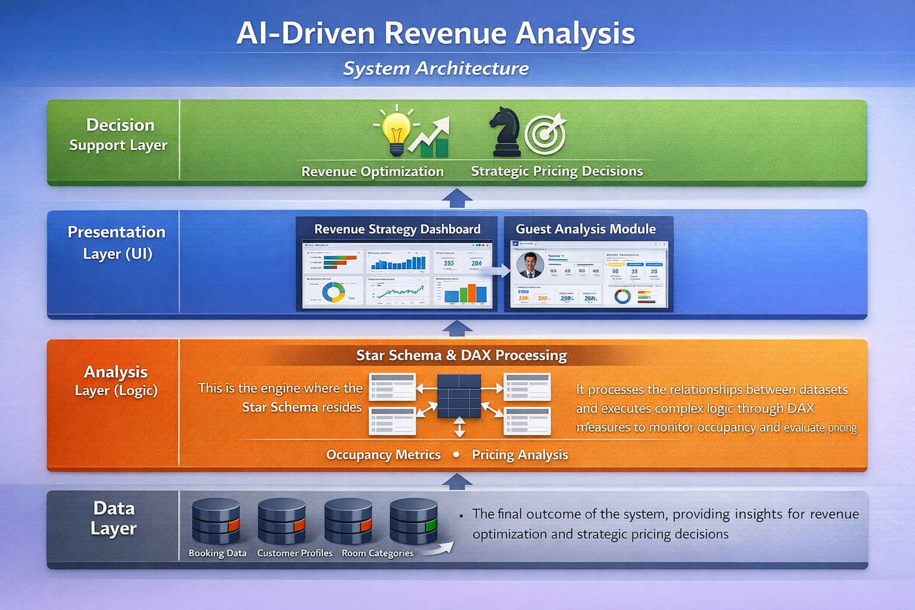
SYSTEM ARCHITECTURE
03

Slide 8
DATA MODEL OVERVIEW
📊Booking Data
Booking ID • Check-in • Check-out • Channel • Total Amount • Nights
👤Customer Data
Customer ID • Nationality • Guest Type • Stay Purpose
🛏 Room Data
Room ID • Room Type • Category • Total Rooms
🏨Hotel Branch Data
Hotel ID • City • Region • Hotel Name
📅Date Table
Year • Quarter • Month • Season
These datasets are loaded into Power BI using structured data ingestion techniques
03

Slide 9
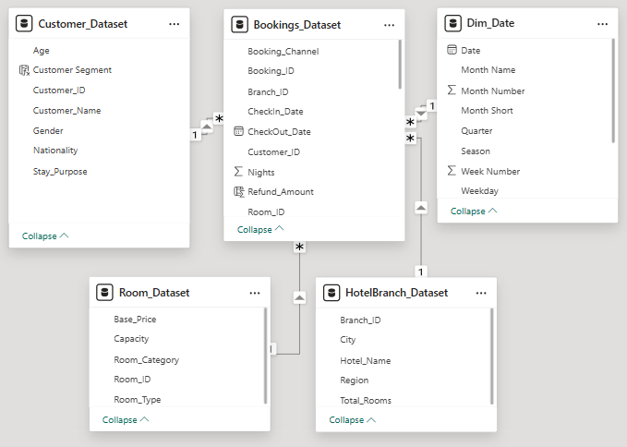
DATA MODELING AND INGESTION
Data modeling and ingestion form the foundation of any successful analytics solution. In the Hotel Revenue Analysis project, This module focuses on integrating raw hotel data from multiple sources and structuring it into an optimized analytical model. This module ensures data consistency, accuracy, and scalability for downstream reporting and visualization in Power BI.
The primary objective of this module is to load booking, customer, room, and hotel branch data, build a star schema model, and derive calculated attributes such as booking duration, room category, and stay type. A well-designed data model improves performance, enables accurate calculations, and supports meaningful business insights.
03

Slide 10
DAX MEASURES
Total Revenue
Total Revenue = CALCULATE(SUM(Bookings_Dataset[Total_Amount]), Bookings_Dataset[Status] IN {"Completed","NoShow"})
Cancelled Bookings
Cancelled Booking = CALCULATE(COUNT(Bookings_Dataset[Booking_ID]),Bookings_ Dataset[Status] = "Cancelled")
ADR(Average Daily Rate)
ADR = DIVIDE([Total Revenue],[Room Nights Sold])
OCCUPANCY RATE %
Occupancy % = DIVIDE([Room Nights Sold],[Total Rooms] * [Total Days]) * 100
BOOKING COUNT
Booking Count = COUNT(Bookings_Dataset[Booking_ID])
03

Slide 11
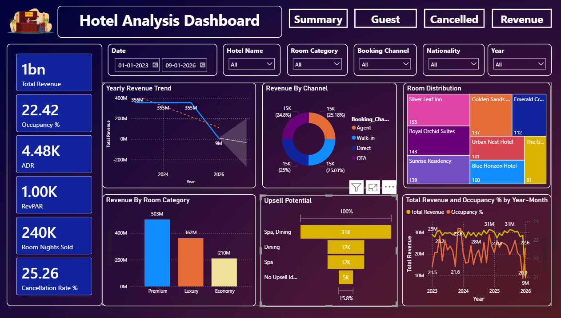
OCCUPANCY AND REVENUE METRICS
This module focuses on evaluating hotel performance using key occupancy and revenue metrics. This module translates raw booking data into actionable KPIs such as Occupancy %, ADR (Average Daily Rate), and RevPAR (Revenue per Available Room). These metrics are essential for hotel management to track operational efficiency, pricing strategy, and revenue optimization.
The Power BI dashboards created in this module provide both high-level summaries and detailed trend analysis across time, location, and booking channels.
03

Slide 12
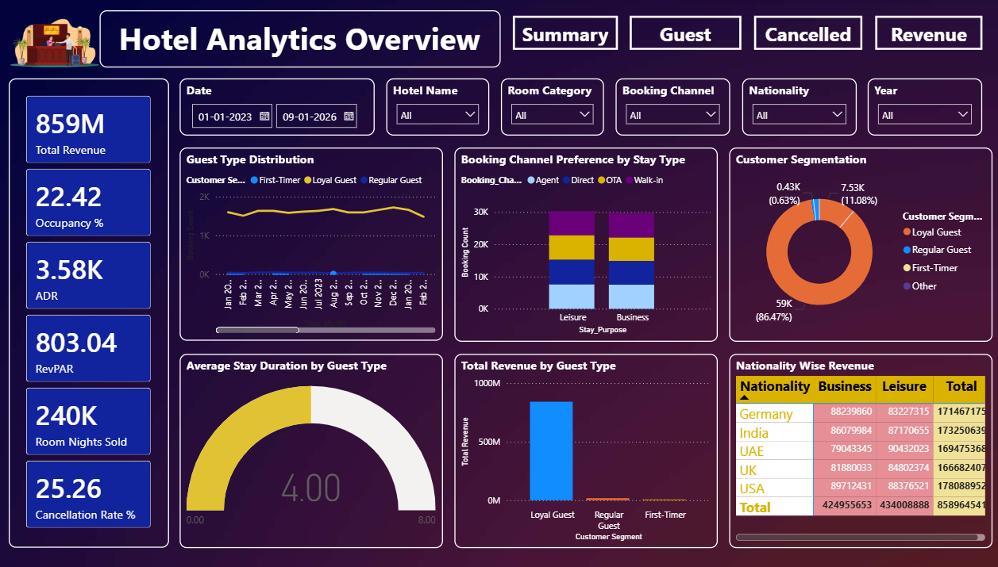
GUEST ANALYSIS
The Guest Analysis focuses on evaluating guest behavior, booking preferences, revenue contribution, and occupancy impact. By analyzing guest type distribution, booking channel preference, customer segmentation, stay duration, and nationality-based revenue, this module enables hotels to understand high-value customers and optimize engagement strategies.
The insights derived help improve retention, enhance service personalization, and support revenue-driven decision-making in hospitality operations.
03

Slide 13
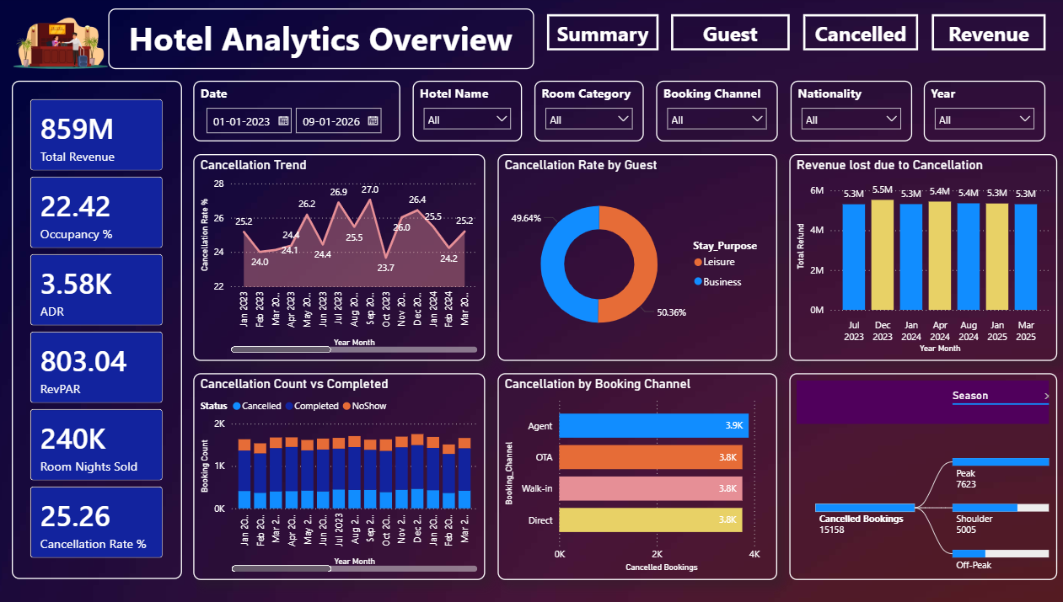
FORECASTING AND CANCELLATION TRENDS
The Forecasting & Cancellation Trends focuses on analyzing booking reliability, cancellation behaviour, and revenue loss patterns. This dashboard supports hotel management in understanding cancellation trends, seasonal impacts, and booking channel risks. By examining cancellation rates, revenue loss, and booking status distribution, the module enables proactive decision-making to reduce revenue leakage and improve operational planning.
It also helps management anticipate potential financial risks before they significantly impact overall revenue performance.
03

Slide 14
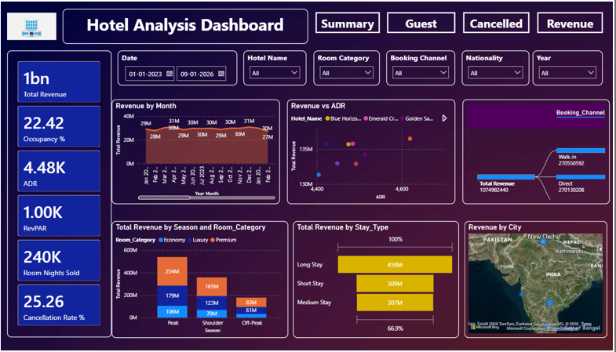
REVENUE STRATEGY DASHBOARD
The Revenue Strategy Dashboard focuses on analyzing total revenue performance, pricing efficiency, seasonal contribution, and geographic revenue distribution. This module enables hotel management to evaluate revenue drivers, understand pricing impact (ADR), and identify high-performing segments across seasons and cities.
By integrating KPIs, trend analysis, seasonal comparison, and booking channel insights, the dashboard supports data-driven revenue optimization and strategic planning.
03

Slide 15
CONCLUSION
In conclusion, this project demonstrates how data analytics and Power BI can transform raw hotel booking data into meaningful business insights. By analyzing KPIs like ADR, RevPAR, and occupancy rate, the dashboard helps management optimize pricing strategies, reduce revenue loss from cancellations, and improve overall performance.
FUTURE ENCHANCEMENTS
Implement AI-based revenue and occupancy forecasting
Develop dynamic pricing recommendation system
Integrate real-time booking data from live systems
Add advanced customer segmentation and loyalty analysis
Deploy mobile-friendly dashboard for management access
Introduce automated alerts for revenue and cancellation trends
Integrate cloud storage for scalable data management
03

Slide 16
THANK YOU
03

